Slide 1
Chapter 4
Relationships

Slide 2
The Entity Relationship (ER) Model
ER model forms the basis of an ER diagram
ERD represents the conceptual database as viewed by end user
ERDs depict the ER model’s three main components:
  Entities
  Attributes
  Relationships
Database Systems: Design, Implementation, & Management, 6th Edition, Rob & Coronel

Slide 3
Entities
Refers to the entity set and not to a single entity occurrence
Corresponds to a table and not to a row in the relational environment
In both the Chen and Crow’s Foot models, an entity is represented by a rectangle containing the entity’s name
Entity name, a noun, is usually written in capital letters
Database Systems: Design, Implementation, & Management, 6th Edition, Rob & Coronel

Slide 4
Attributes
Characteristics of entities
In Chen model, attributes are represented by ovals and are connected to the entity rectangle with a line
Each oval contains the name of the attribute it represents
In the Crow’s Foot model, the attributes are simply written in the attribute box below the entity rectangle
Database Systems: Design, Implementation, & Management, 6th Edition, Rob & Coronel

Slide 5
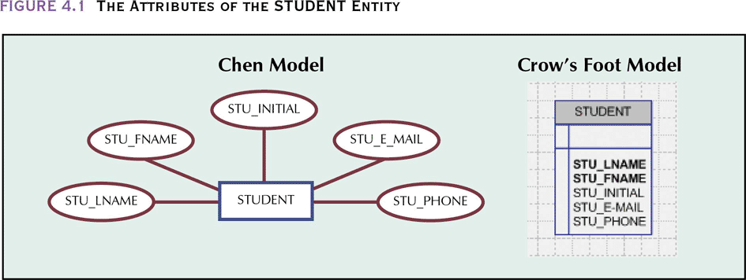
The Attributes of the STUDENT Entity
Database Systems: Design, Implementation, & Management, 6th Edition, Rob & Coronel

Slide 6
Domains
Attributes have a domain:
  The attribute’s set of possible values
Attributes may share a domain
Database Systems: Design, Implementation, & Management, 6th Edition, Rob & Coronel

Slide 7
Primary Keys
Underlined in the ER diagram
Key attributes are also underlined in frequently used table structure shorthand
Ideally composed of only a single attribute
Possible to use a composite key:
  Primary key composed of more than one attribute
Database Systems: Design, Implementation, & Management, 6th Edition, Rob & Coronel

Slide 8
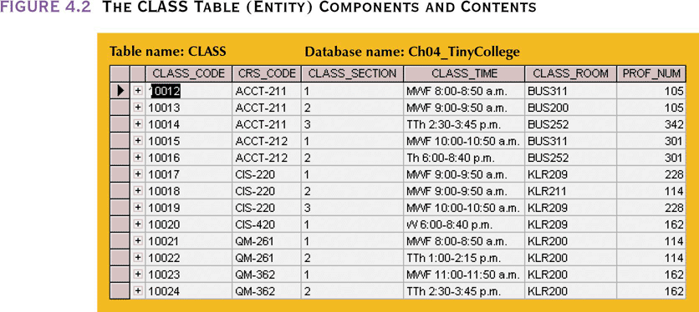
The CLASS Table (Entity)
Components and Contents
Database Systems: Design, Implementation, & Management, 6th Edition, Rob & Coronel

Slide 9
Attributes
Composite attribute
Simple attribute
Single-value attribute
Multivalued attributes
Database Systems: Design, Implementation, & Management, 6th Edition, Rob & Coronel

Slide 10
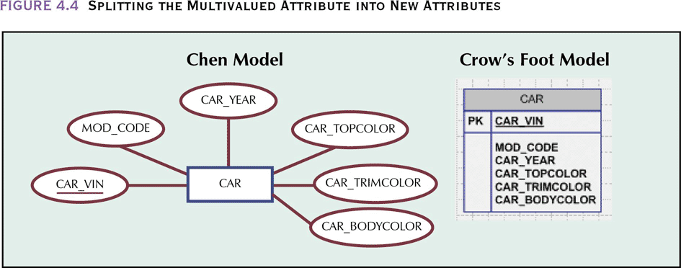
Splitting the Multivalued
Attribute into New Attributes
Database Systems: Design, Implementation, & Management, 6th Edition, Rob & Coronel

Slide 11
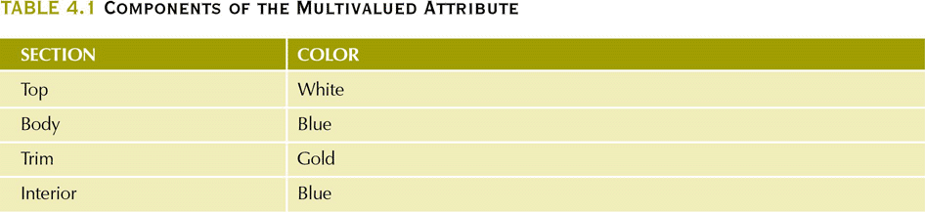
Components of the Multivalued Attribute
Database Systems: Design, Implementation, & Management, 6th Edition, Rob & Coronel

Slide 12
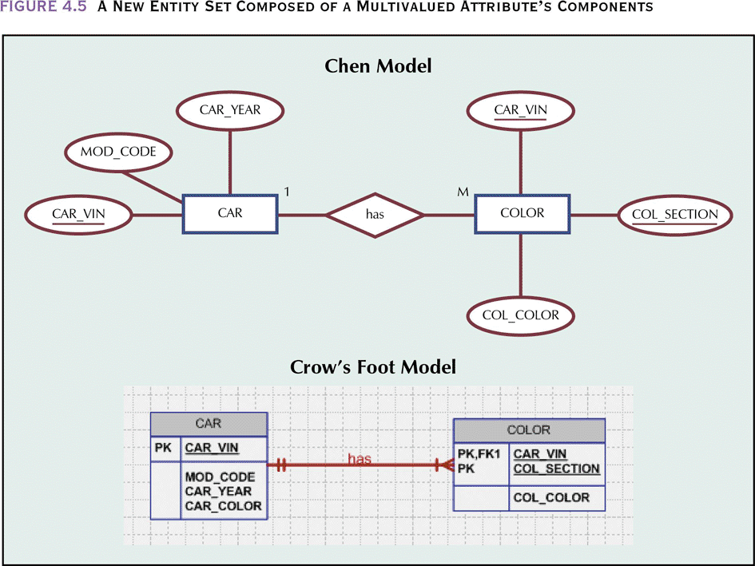
A New Entity Set Composed of a Multivalued Attribute’s Components
Database Systems: Design, Implementation, & Management, 6th Edition, Rob & Coronel

Slide 13
Derived Attributes
Attribute whose value may be calculated (derived) from other attributes
Need not be physically stored within the database
Can be derived by using an algorithm
Database Systems: Design, Implementation, & Management, 6th Edition, Rob & Coronel

Slide 14
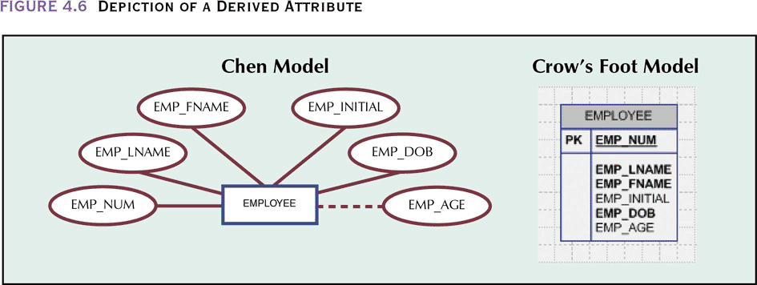
Depiction of a Derived Attribute
Database Systems: Design, Implementation, & Management, 6th Edition, Rob & Coronel

Slide 15
Relationships
It is worth remembering that each table represents a type of object in the real world. Therefore each entity in a table refers to a real person or thing
An EMPLOYEES table would represent a real employee.
The first step in deciding what relationships we need to set up between the tables is to ask the question
“What types of relationships can exist between these real world objects?”

Slide 16
What is a Relationship
An Association between entities
Participants:
  Entities that participate in a relationship
Relationships between entities always operate in both directions
Relationship can be classified as 1:M
Relationship classification is difficult to establish if you only know one side
Database Systems: Design, Implementation, & Management, 6th Edition, Rob & Coronel

Slide 17
Relationship classification
It turns out that there are four possible kinds of relationship between any
given pair of objects, as follows:
One-to-many
One-to-one
Many-to-many
None

Slide 18
Connectivity and Cardinality
Connectivity
  Used to describe the relationship classification
Cardinality
  Expresses the specific number of entity occurrences associated with one occurrence of the related entity
Established by very concise statements known as business rules
Database Systems: Design, Implementation, & Management, 6th Edition, Rob & Coronel

Slide 19
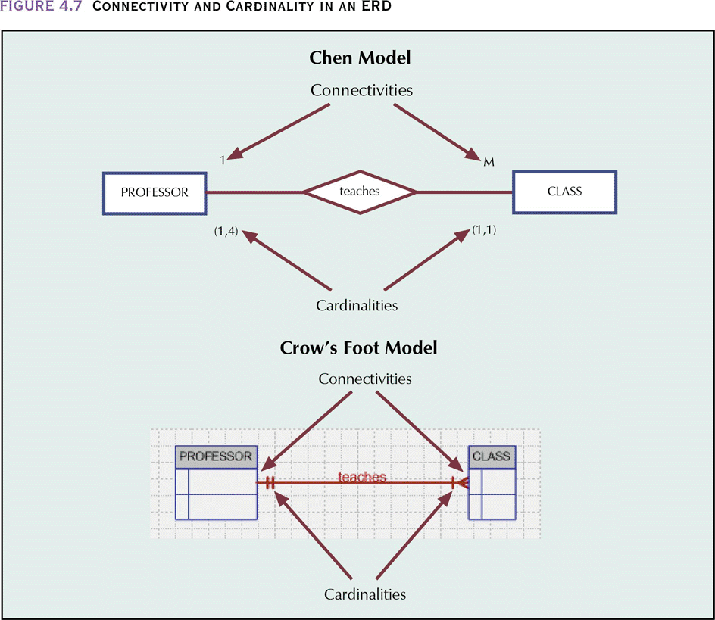
Connectivity and Cardinality in an ERD
Database Systems: Design, Implementation, & Management, 6th Edition, Rob & Coronel

Slide 20
RELATIONSHIP Strength
Existence dependence
  Entity’s existence depends on the existence of one or more other entities
Existence independence
  Entity can exist apart from one or more related entities
Weak (non-identifying) relationships
  One entity is not existence-independent on another entity
Strong (Identifying) Relationships
  Related entities are existence-dependent
Database Systems: Design, Implementation, & Management, 6th Edition, Rob & Coronel

Slide 21
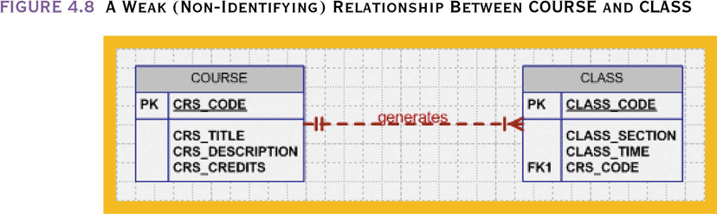
A Weak (Non-Identifying) Relationship Between COURSE and CLASS
Database Systems: Design, Implementation, & Management, 6th Edition, Rob & Coronel

Slide 22
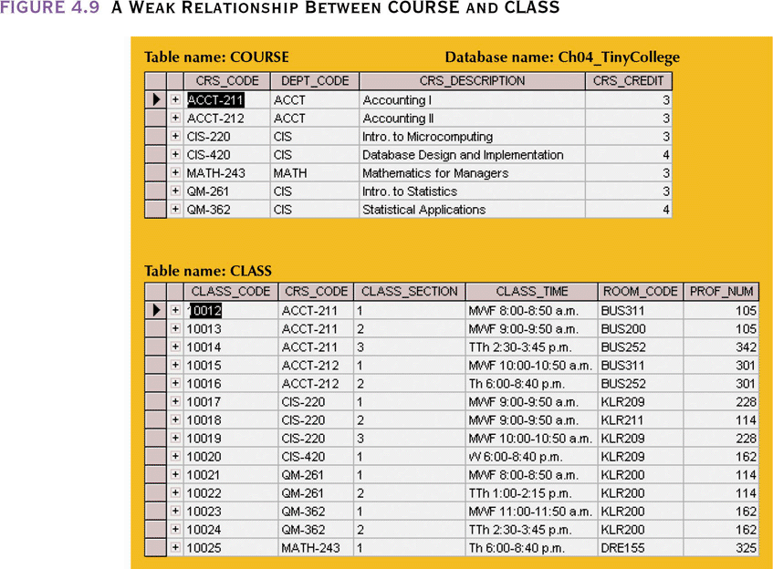
A Weak Relationship
Between COURSE and CLASS
Database Systems: Design, Implementation, & Management, 6th Edition, Rob & Coronel

Slide 23
Relationship Participation
Optional:
  One entity occurrence does not require a corresponding entity occurrence in a particular relationship
Mandatory:
  One entity occurrence requires a corresponding entity occurrence in a particular relationship
Database Systems: Design, Implementation, & Management, 6th Edition, Rob & Coronel

Slide 24
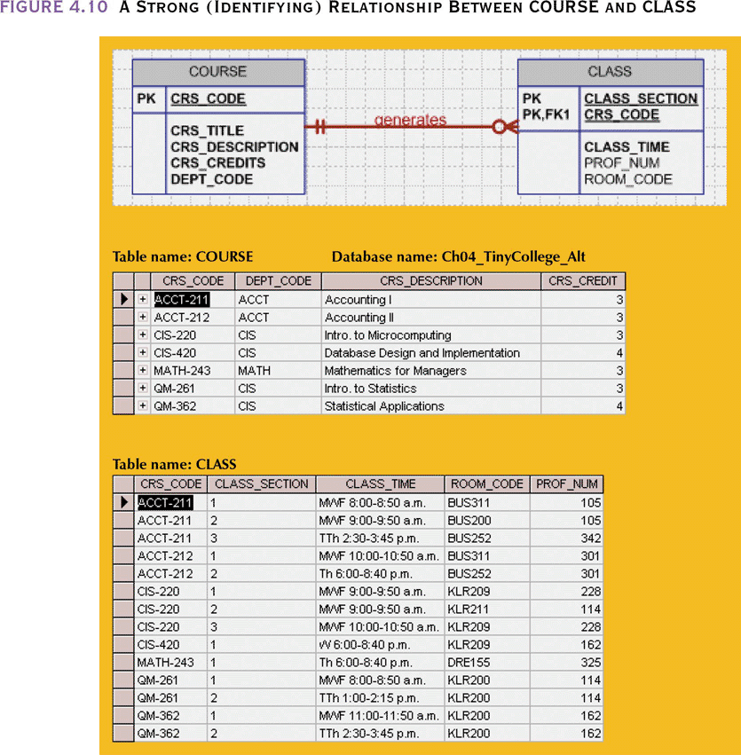
A Strong (Identifying) Relationship Between COURSE and CLASS
Database Systems: Design, Implementation, & Management, 6th Edition, Rob & Coronel

Slide 25
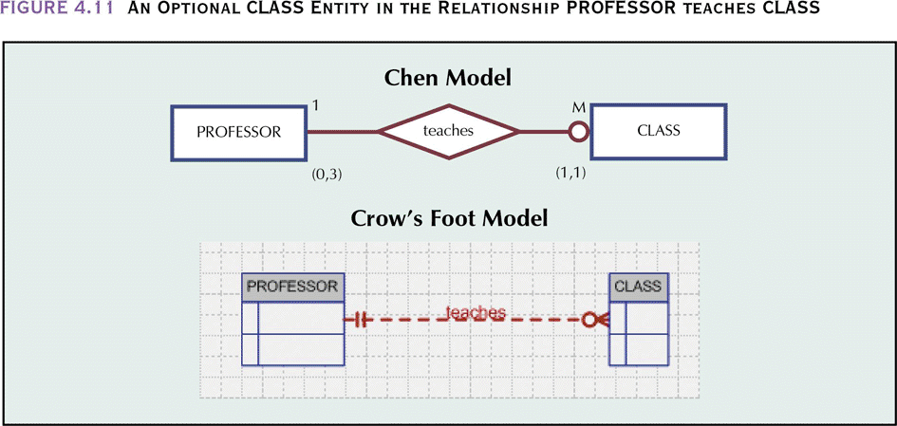
An Optional CLASS Entity in the Relationship PROFESSOR teaches CLASS
Database Systems: Design, Implementation, & Management, 6th Edition, Rob & Coronel

Slide 26
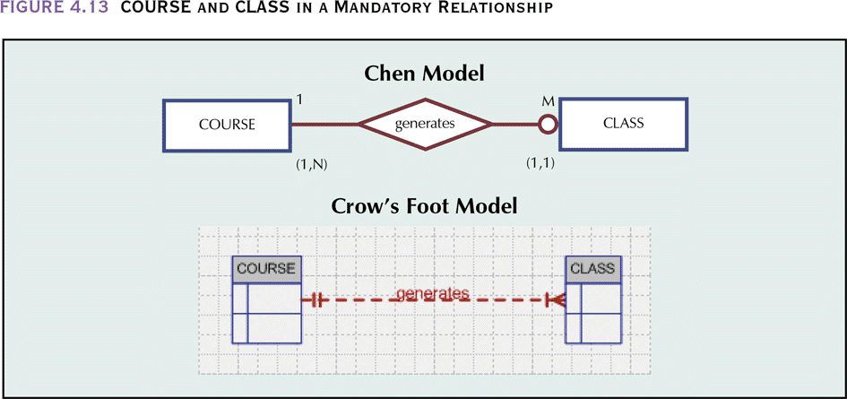
COURSE and CLASS in a Mandatory Relationship
Database Systems: Design, Implementation, & Management, 6th Edition, Rob & Coronel

Slide 27
Relationship Strength and Weak Entities
Weak entity meets two conditions
  Existence-dependent:
    Cannot exist without entity with which it has a relationship
  Has primary key that is partially or totally derived from the parent entity in the relationship
Database designer usually determines whether an entity can be described as weak based on the business rules
Database Systems: Design, Implementation, & Management, 6th Edition, Rob & Coronel

Slide 28
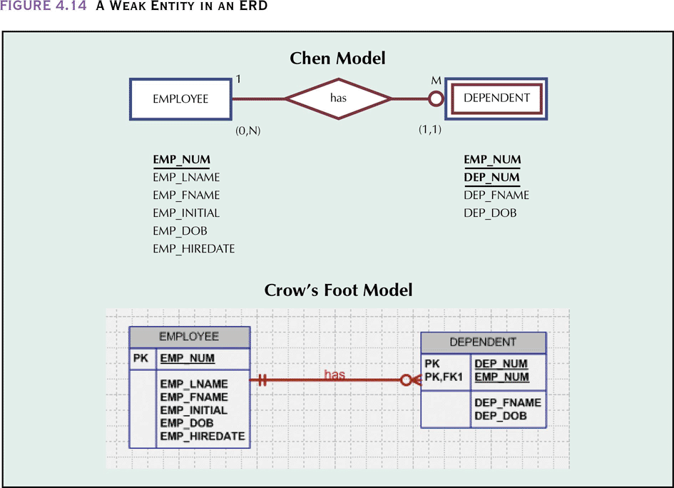
A Weak Entity in an ERD
Database Systems: Design, Implementation, & Management, 6th Edition, Rob & Coronel

Slide 29
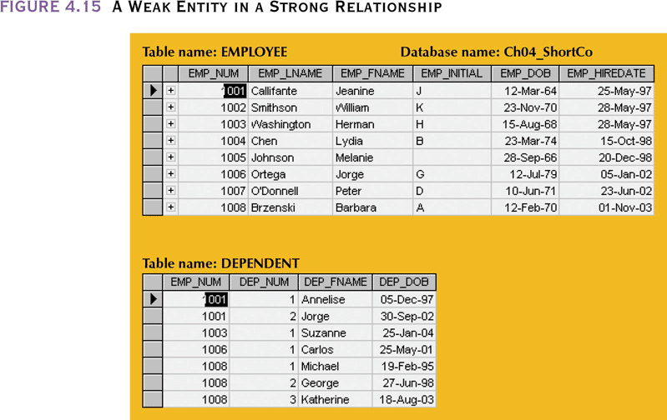
A Weak Entity in a Strong Relationship
Database Systems: Design, Implementation, & Management, 6th Edition, Rob & Coronel

Slide 30
Relationship Degree
Indicates number of associated entities or participants
Unary relationship
  Association is maintained within a single entity
Binary relationship
  Two entities are associated
Ternary relationship
  Three entities are associated
Database Systems: Design, Implementation, & Management, 6th Edition, Rob & Coronel

Slide 31
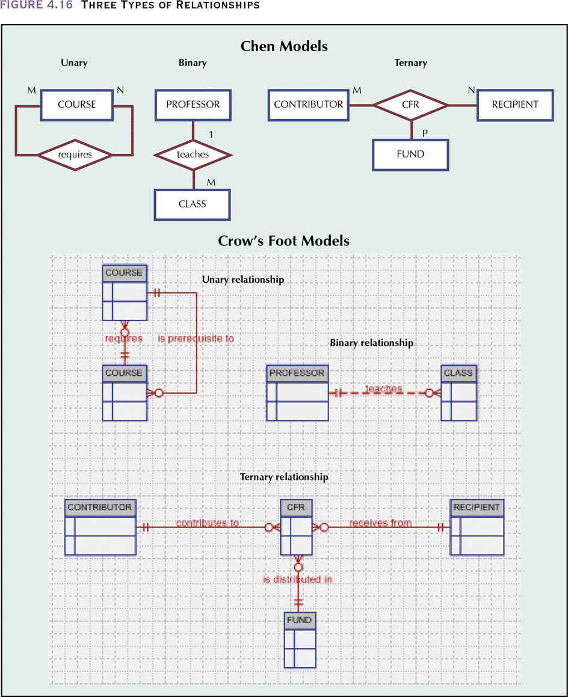
Three Types of Relationships
Database Systems: Design, Implementation, & Management, 6th Edition, Rob & Coronel

Slide 32
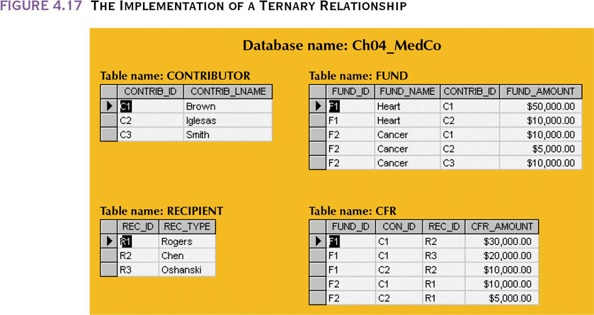
The Implementation of a Ternary Relationship
Database Systems: Design, Implementation, & Management, 6th Edition, Rob & Coronel

Slide 33
Recursive Relationships
Relationship can exist between occurrences of the same entity set
Naturally found within a unary relationship
Database Systems: Design, Implementation, & Management, 6th Edition, Rob & Coronel

Slide 34
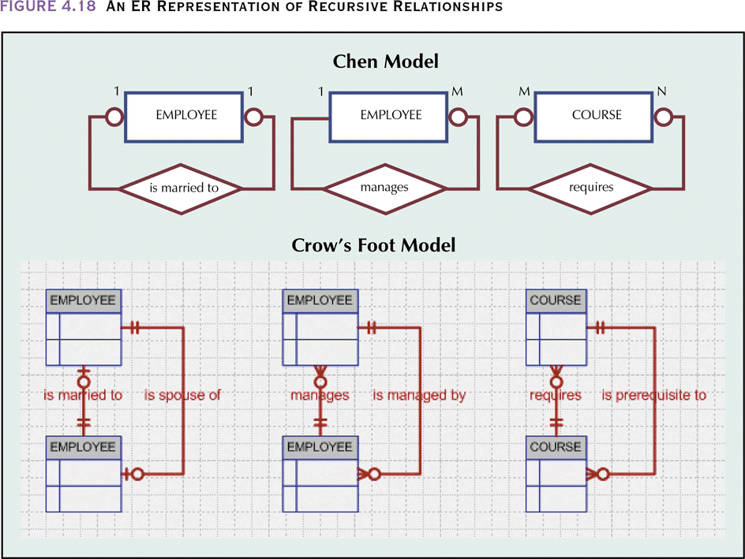
An ER Representation of Recursive Relationships
Database Systems: Design, Implementation, & Management, 6th Edition, Rob & Coronel

Slide 35
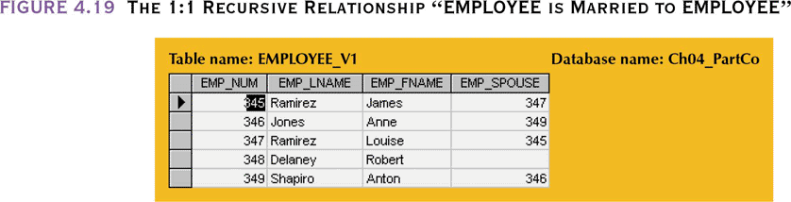
The 1:1 Recursive Relationship “EMPLOYEE is Married to EMPLOYEE”
Database Systems: Design, Implementation, & Management, 6th Edition, Rob & Coronel

Slide 36
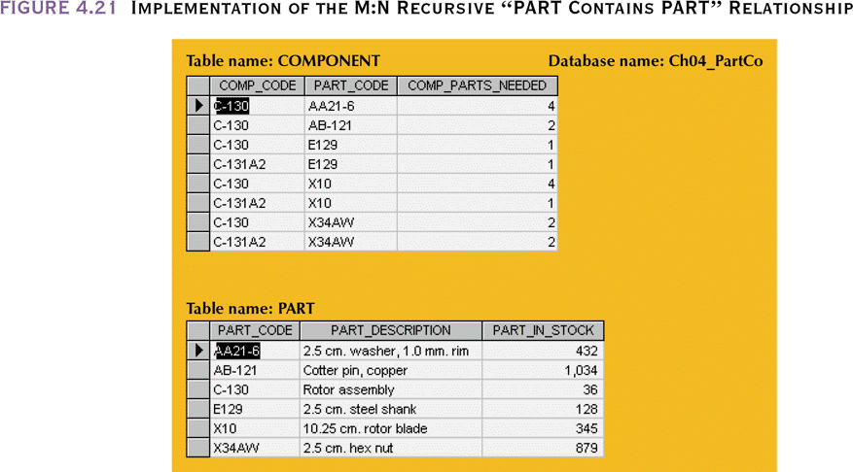
Implementation of the M:N Recursive “PART Contains PART” Relationship
Database Systems: Design, Implementation, & Management, 6th Edition, Rob & Coronel

Slide 37
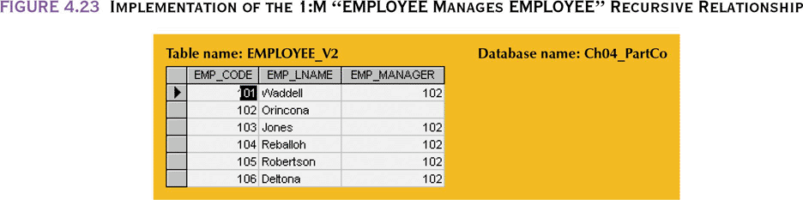
Implementation of the 1:M “EMPLOYEE Manages EMPLOYEE” Recursive Relationship
Database Systems: Design, Implementation, & Management, 6th Edition, Rob & Coronel

Slide 38
Composite Entities
Also known as bridge entities
Composed of the primary keys of each of the entities to be connected
May also contain additional attributes that play no role in the connective process
Database Systems: Design, Implementation, & Management, 6th Edition, Rob & Coronel

Slide 39
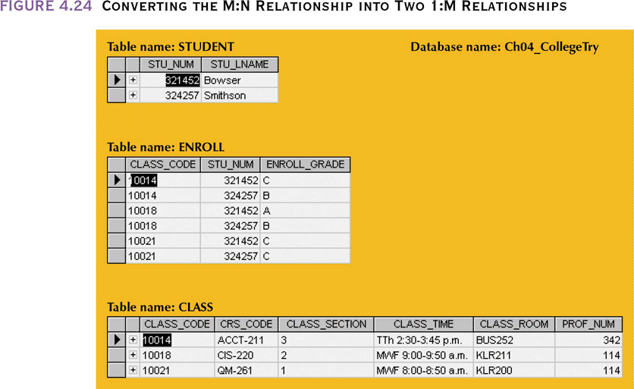
Converting the M:N Relationship into Two 1:M Relationships
Database Systems: Design, Implementation, & Management, 6th Edition, Rob & Coronel

Slide 40
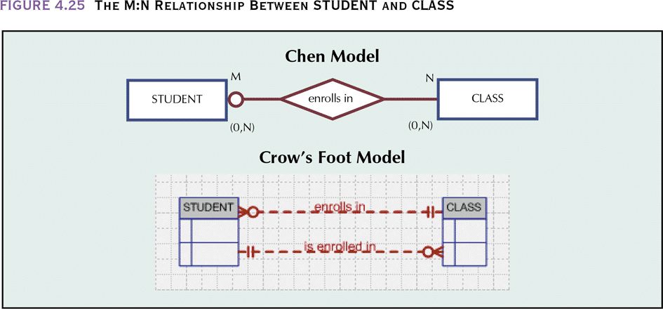
The M:N Relationship
Between STUDENT and CLASS
Database Systems: Design, Implementation, & Management, 6th Edition, Rob & Coronel

Slide 41
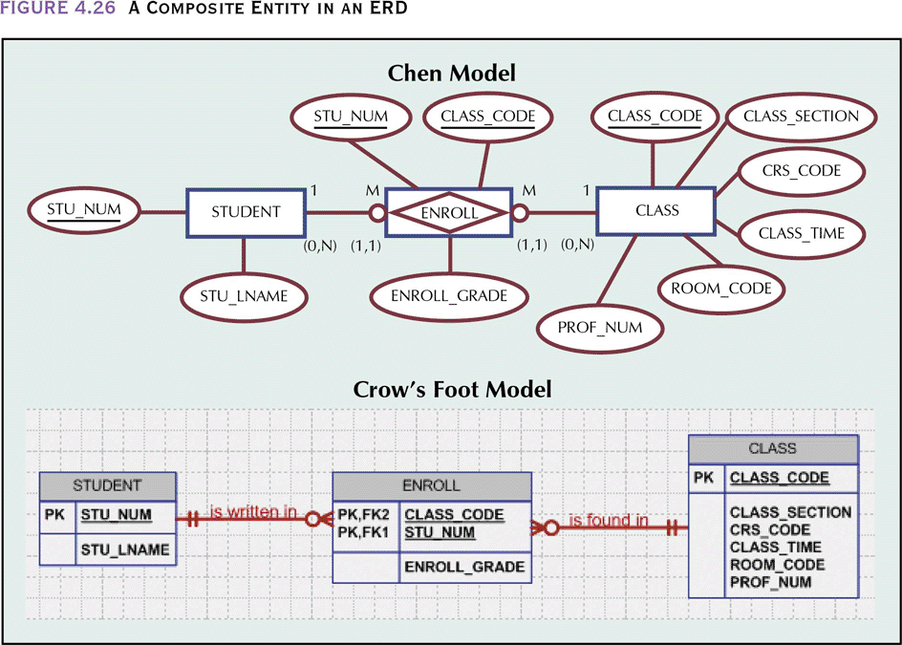
A Composite Entity in an ERD
Database Systems: Design, Implementation, & Management, 6th Edition, Rob & Coronel

Slide 42
Entity Supertypes and Subtypes
Generalization hierarchy
  Depicts a relationship between a higher-level supertype entity and a lower-level subtype entity
Supertype entity
  Contains shared attributes
Subtype entity
  Contains unique attributes
Database Systems: Design, Implementation, & Management, 6th Edition, Rob & Coronel

Slide 43
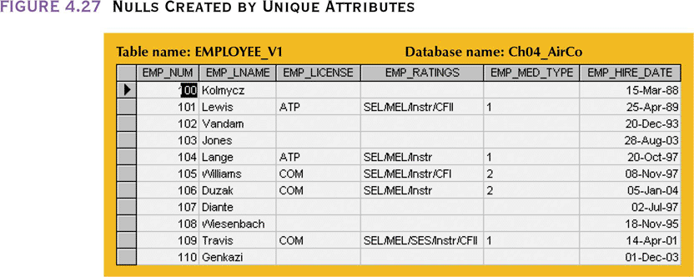
Nulls Created by Unique Attributes
Database Systems: Design, Implementation, & Management, 6th Edition, Rob & Coronel

Slide 44
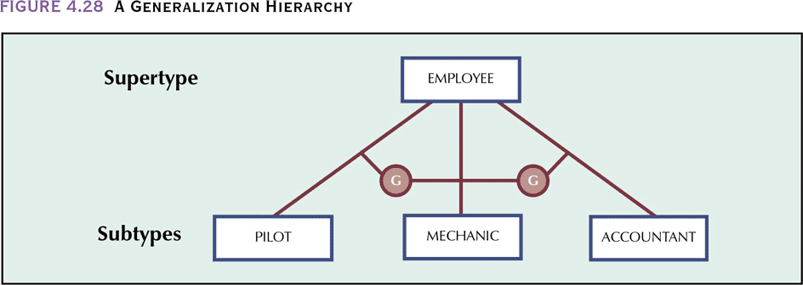
A Generalization Hierarchy
Database Systems: Design, Implementation, & Management, 6th Edition, Rob & Coronel

Slide 45
Disjoint Subtypes
Also known as non-overlapping subtypes
  Subtypes that contain a subset of the supertype entity set
  Each entity instance (row) of the supertype can appear in only one of the disjoint subtypes
Supertype and its subtype(s) maintain a 1:1 relationship
Database Systems: Design, Implementation, & Management, 6th Edition, Rob & Coronel

Slide 46
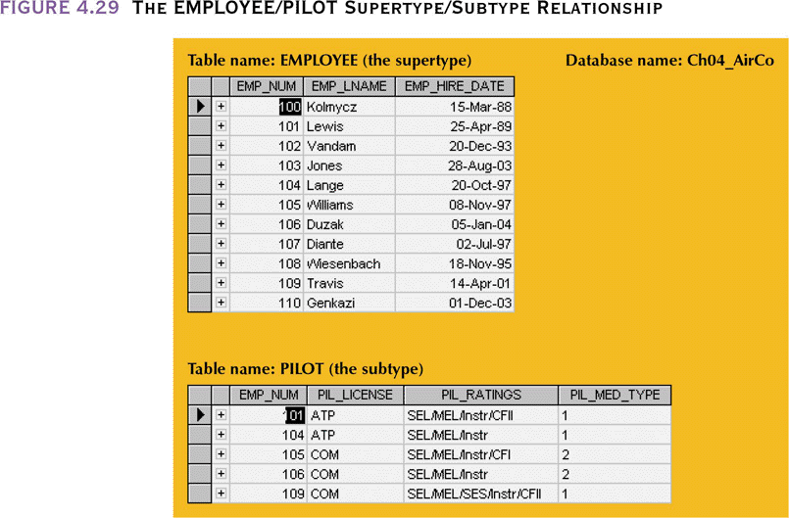
The EMPLOYEE/PILOT Supertype/Subtype Relationship
Database Systems: Design, Implementation, & Management, 6th Edition, Rob & Coronel

Slide 47
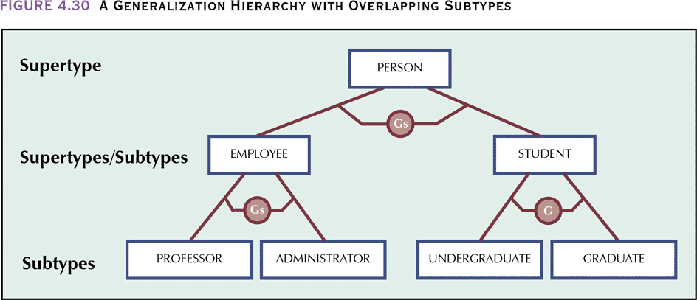
A Generalization Hierarchy with Overlapping Subtypes
Database Systems: Design, Implementation, & Management, 6th Edition, Rob & Coronel

Slide 48
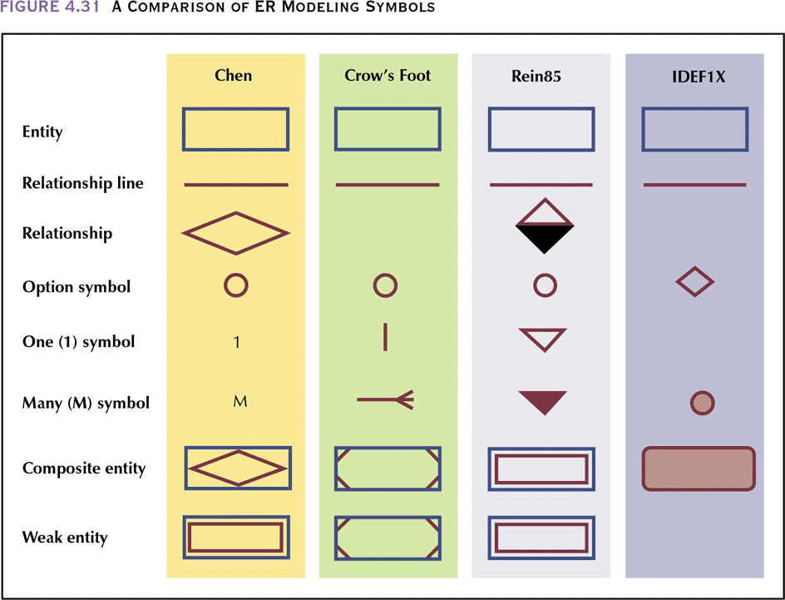
A Comparison of ER Modeling Symbols
Database Systems: Design, Implementation, & Management, 6th Edition, Rob & Coronel

Slide 49
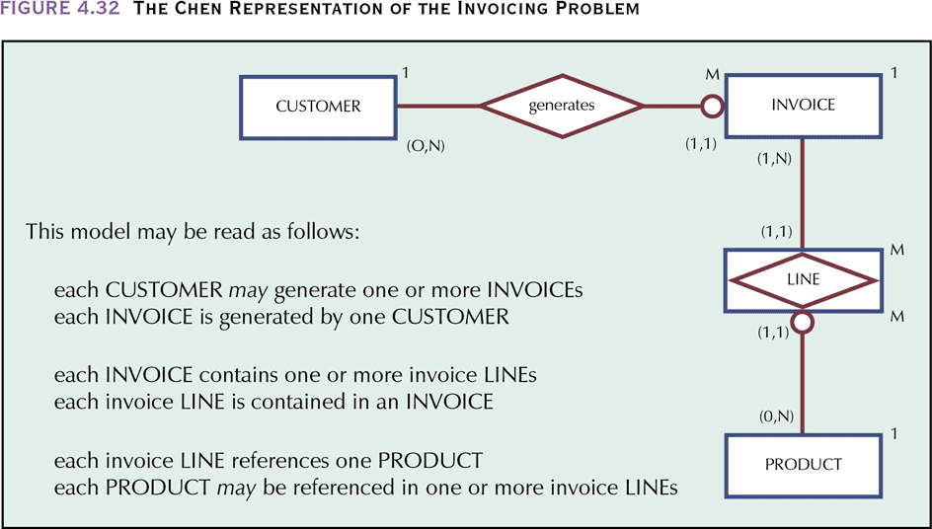
The Chen Representation of the Invoicing Problem
Database Systems: Design, Implementation, & Management, 6th Edition, Rob & Coronel

Slide 50
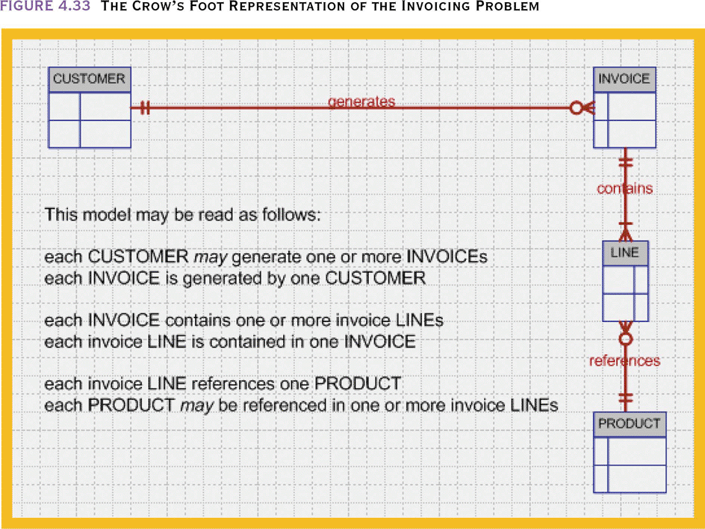
The Crow’s Foot Representation of the Invoicing Problem
Database Systems: Design, Implementation, & Management, 6th Edition, Rob & Coronel

Slide 51
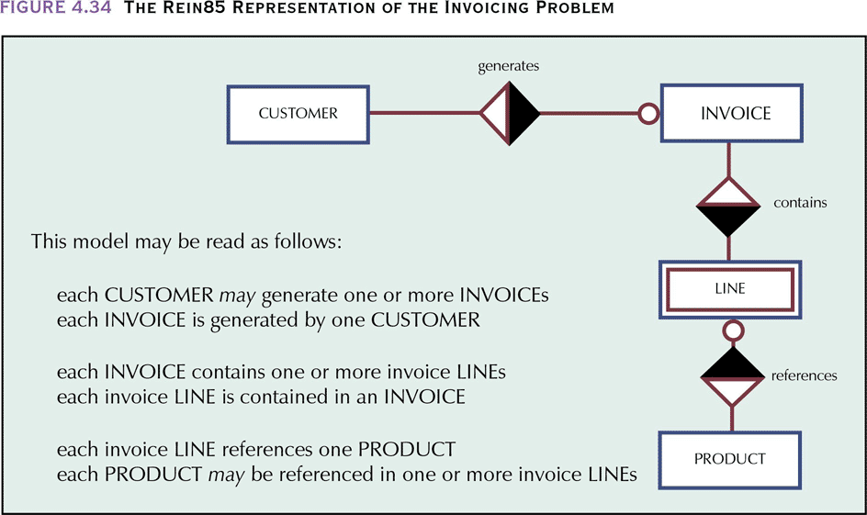
The Rein85 Representation of the Invoicing Problem
Database Systems: Design, Implementation, & Management, 6th Edition, Rob & Coronel

Slide 52
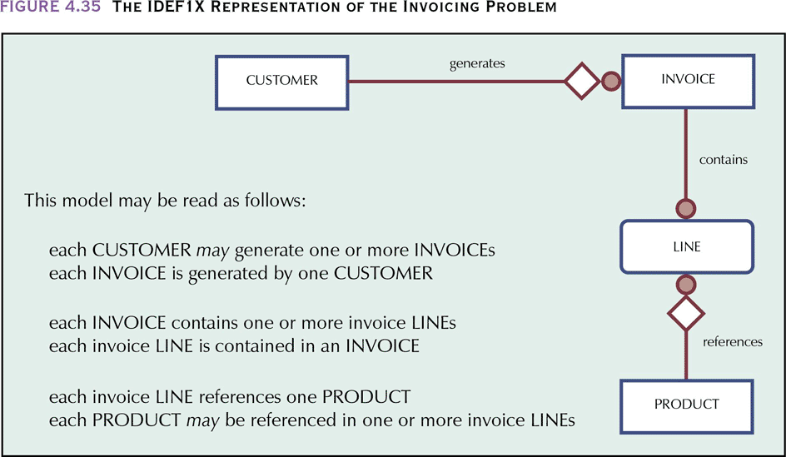
The IDEF1X Representation of the Invoicing Problem
Database Systems: Design, Implementation, & Management, 6th Edition, Rob & Coronel

Slide 53
Developing an ER Diagram
Database design is an iterative rather than a linear or sequential process
Iterative process
  Based on repetition of processes and procedures
Database Systems: Design, Implementation, & Management, 6th Edition, Rob & Coronel

Slide 54
Queries/Views
Queries usually find subsets of the data
By far the most common operation performed on the data in a table is to subset
it.

Slide 55
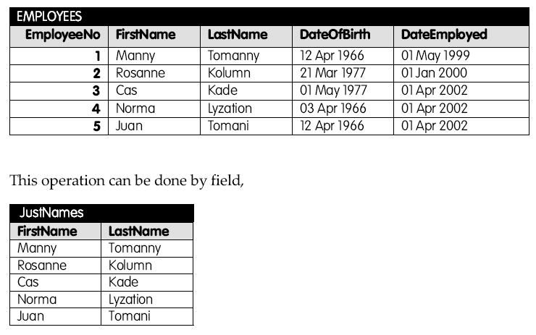

Slide 56
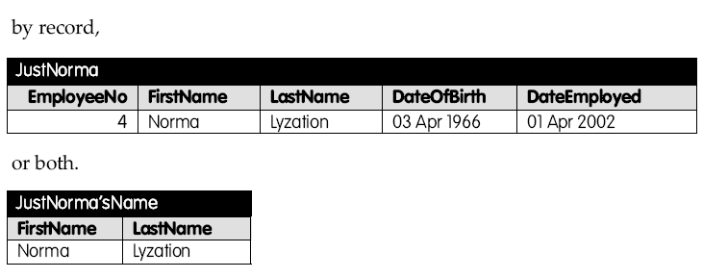

Slide 57
Queries, answer tables and base tables finally defined properly and closure mentioned briefly

